Slide 1
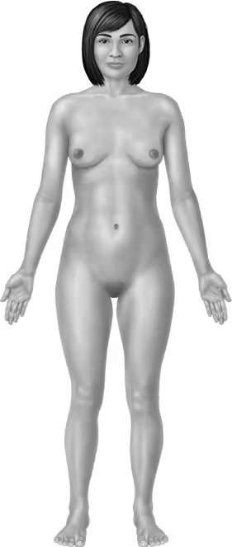
A&B BIOL 206 Lab Report #1
My first & last name is: _____________________________________________
2
How would you describe the indicated direction?
1.
2.
3.
How about the labeled region?
4.
5.
6.
7.
8.
What is the position called that we assume when describing anatomy?
9.
In which quadrant would you feel pain in if your appendix was inflamed?
10.
4
5
1
3
7
6
8

